Slide 1
Wellbeing and
reading
In partnership with
T: 020 7587 1842
W: literacytrust.org.uk
Twitter: @Literacy_Trust
Facebook: nationalliteracytrust
Instagram: @literacy_trust

Slide 2
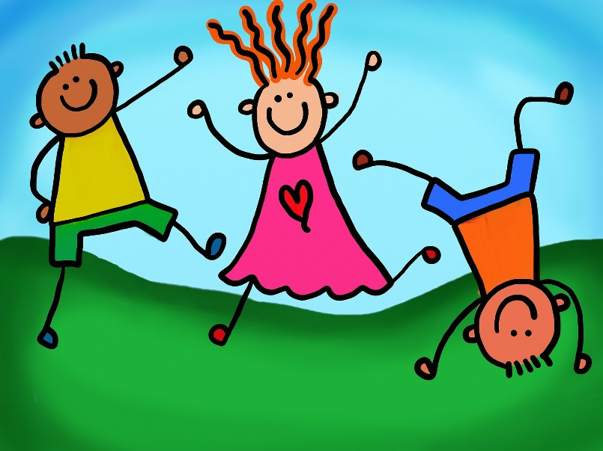
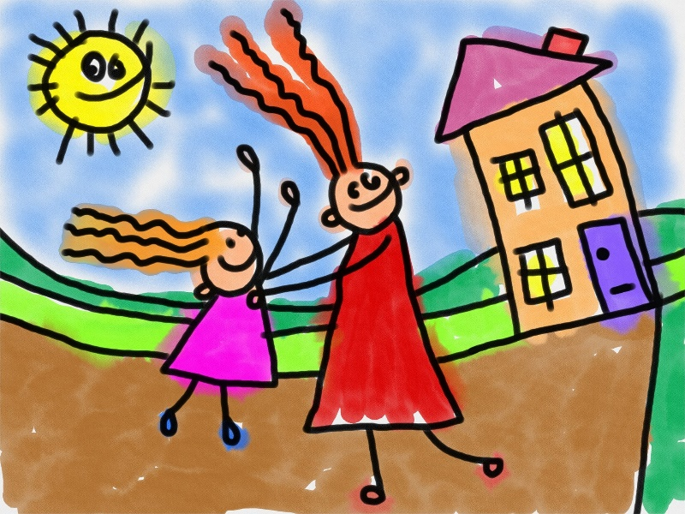
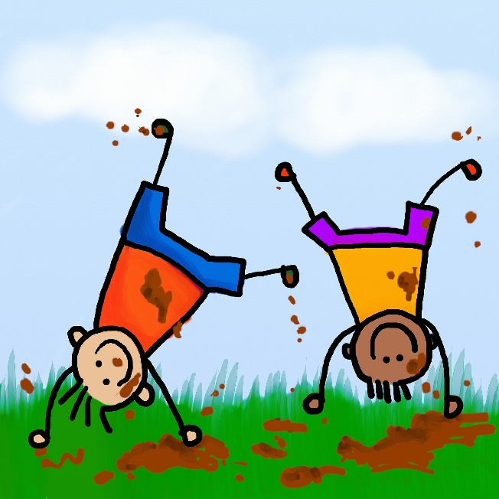
What do we mean by wellbeing?
“The state of being comfortable, healthy, or happy.”
Oxford Dictionary
1

Slide 3
What can stop us feeling happy?
Friendship problems
Family problems
School work
Loneliness
Grief
Feeling different
Fear
2

Slide 4
We all feel like this sometimes
3

Slide 5
What can we do to help ourselves?
One of the really easy ways you can look after yourself if you're worried is...
READING !
4

Slide 6
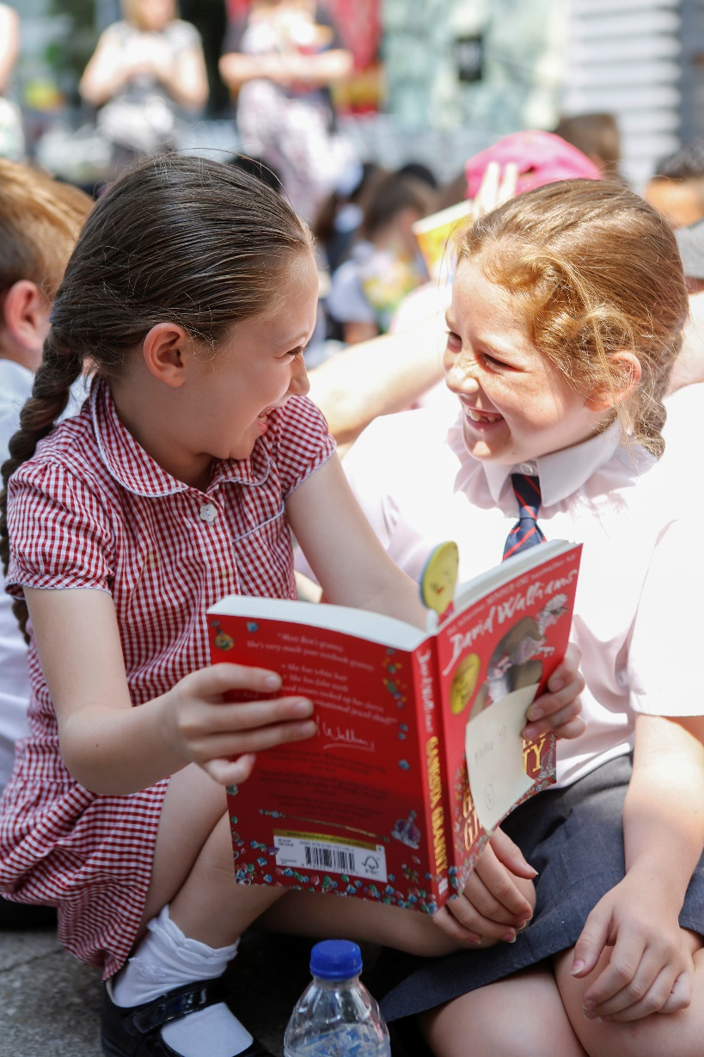
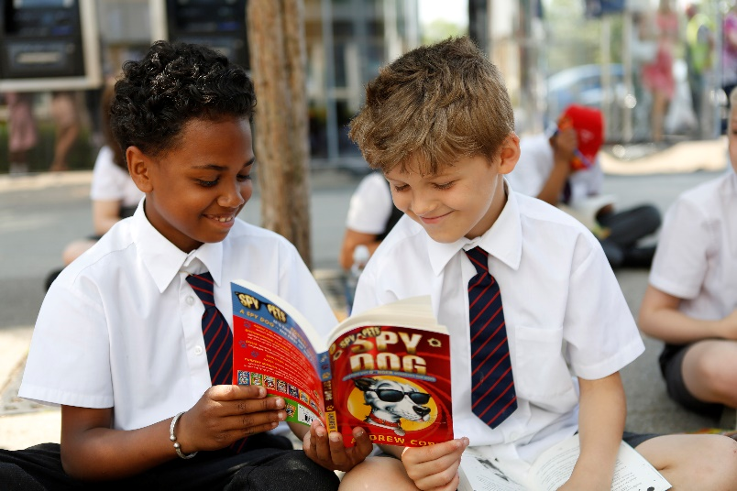
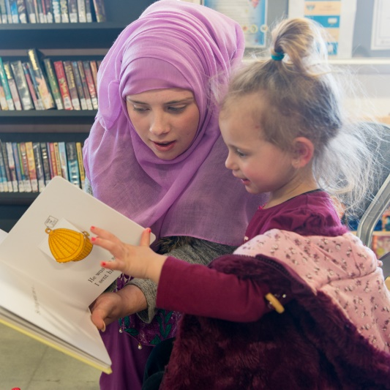
How can reading for enjoyment help?
Reading for enjoyment can:
Help you feel you are not alone
Help you find out about things that are difficult to talk about
Help you understand things you are not sure about
5

Slide 7
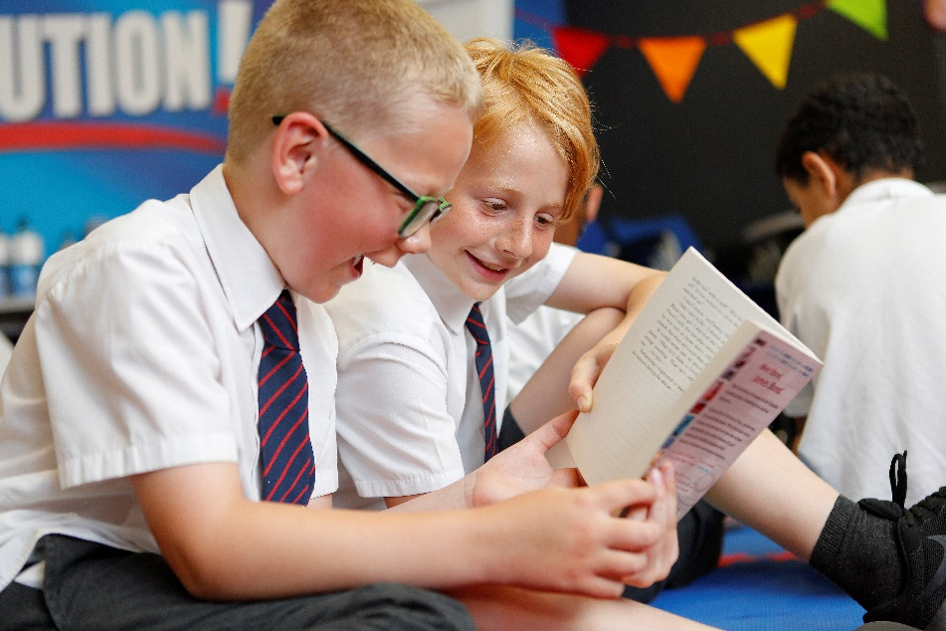
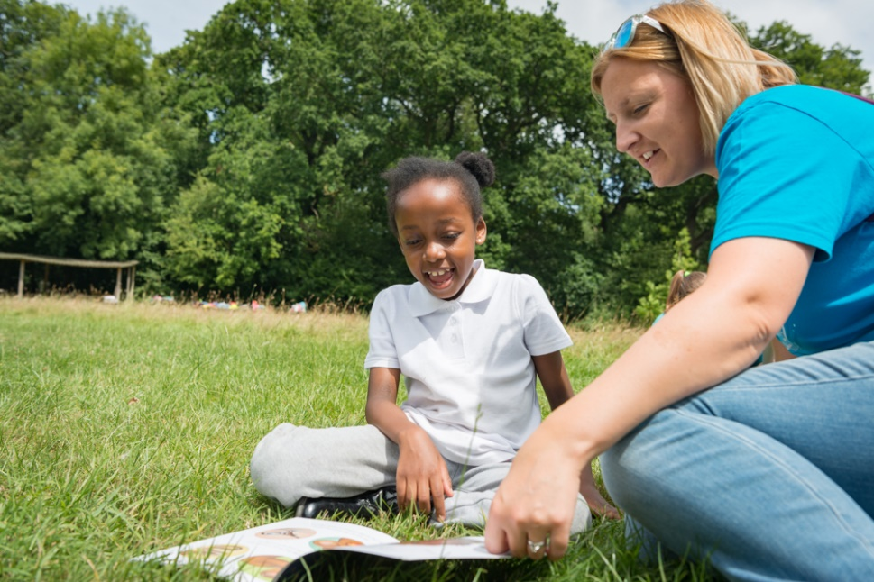
How can reading for enjoyment help?
Reading for enjoyment can:
Help you share things with others
Help you relax
Make you smile!
6

Slide 8
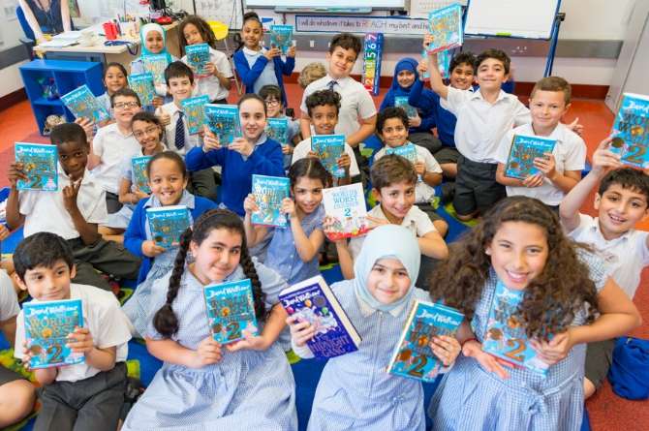
So - let’s get reading!
If you don’t have books at home use your school or local library and borrow them.
Not sure what to read? Ask your librarian, teacher or parent to help you find the right book.
Join your school book group and try reading something new. Share your reading ideas and listen to others.
Read anywhere – you can take books with you wherever you go.
7

Slide 9
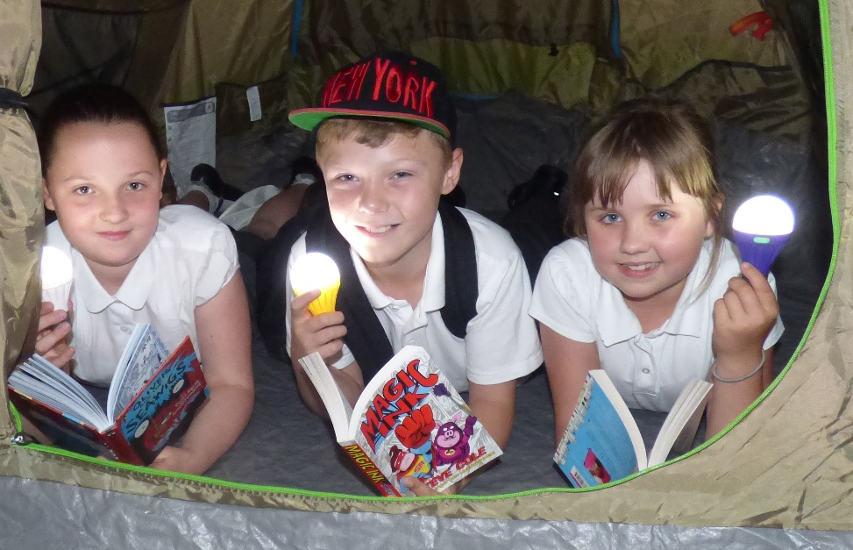
Read everything and everywhere!
Read whatever you enjoy – chapter books, graphic novels, comics, poetry and short stories.
Read aloud or listen to an audio book – if you can’t read well, ask someone to read aloud to you.
Talk about books with your friends and family and celebrate what you’ve read.
8

Slide 10
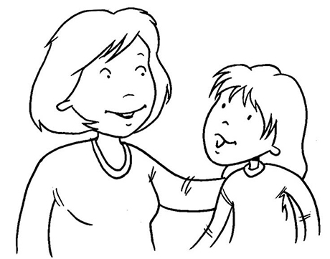
Don’t forget...
If you’re worried or anxious about anything, or if you’re concerned for a friend, talk to a grown up such as a teacher or a family member. They should be able to help.
9

Slide 11
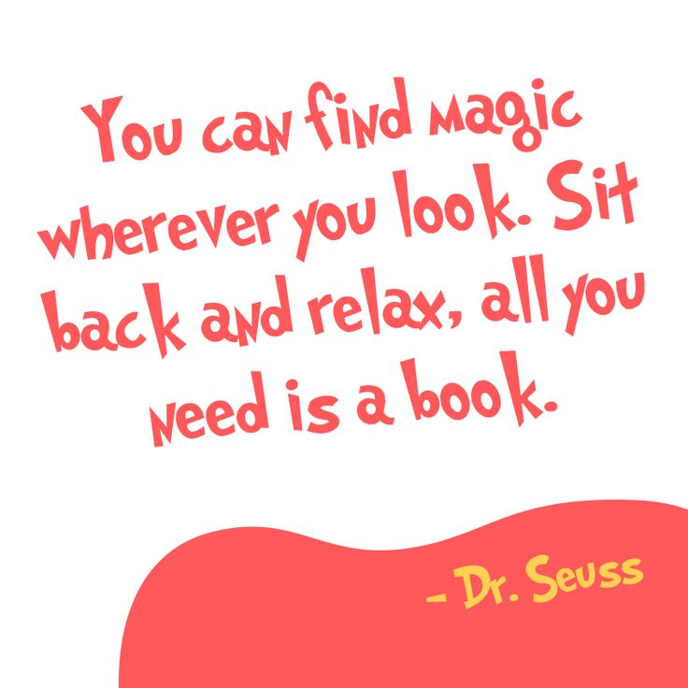
In partnership with

