Slide 1
FAKE NEWS

Slide 2
What is ‘Fake news’?
What might the term ‘fake news’ mean?
Where might you find fake news?
Can you think of any examples of fake news you’ve seen or heard about?

Slide 3
Definition:
Fake news refers to false, often sensational, information disseminated under the guise of news reporting.
Fake news websites and channels produce their fake news content in order to mislead its consumers and spread misinformation via social networks and word-of-mouth.
Fake news is often done to gain attention, to mislead, deceive or damage a reputation.

Slide 4
Why is it a problem?
Although news is frequently biased, we generally rely on it as a source of truthful and reliable information.
Journalists are bound by codes of conduct which set out good, ethical practice.
Good practice includes:
the double-checking of sources
giving those criticised a ‘right of reply’
respecting people’s privacy
Preventing the public from being misled by an action or statement of an individual or organisation.
However, technology has now made it easy for anyone to spread information without rules or regulation.
Unfortunately, this has meant that there is an influx of news coming from unreliable sources with the intention of distorting the truth.
Therefore, we need to be aware of how to identify fake news and learn how to counteract it.

Slide 5
The arrival of online news…
Rise of technology…
Social media sites, such as Facebook, rely on advertising revenue. Therefore, social media is often full of fake ‘clickbait’ headlines which encourage users to click on advertising links.
Such reliance on advertising means fake news is often automatically circulated without being checked for reliability.

Slide 6
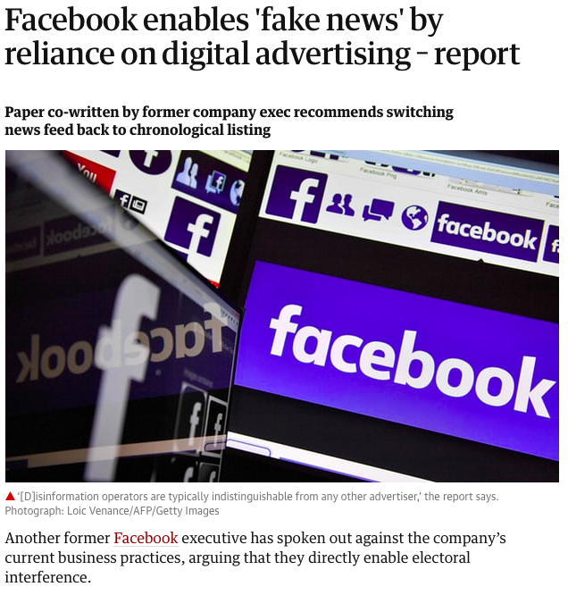

Slide 7
Why might fake news spread on social media?
To become a victim of fake news is not due to personal failings or stupidity INSTEAD people are just simply more likely to seek out and believe stories which justify their pre-existing beliefs whether or not they are true.
Social media provides a unique opportunity for users to publicly declare their beliefs creating a rise in partisan conflicts – politics can quickly become personal.

Slide 8
Definition:
Partisan –
“a strong supporter of a party, cause, or person.”
Fake news can often be used to stir up conflicts between conflicting partisan groups by pushing negative stories about the opposing sides to the other. This can escalate to affect people’s faith in governments and the governments ability to function.

Slide 9
How fake news goes viral – a case study:
Eric Tucker, a 35-year-old in Austin, Texas, had only around 40 Twitter followers. But his tweet about paid protesters being bused to demonstrations against President Donald Trump fueled a viral conspiracy theory — one that Mr. Trump joined in promoting.
Mr. Tucker's post was shared at least 16,000 times on Twitter and more than 350,000 times on Facebook. However, Tucker got it wrong. There were no such buses packed with paid protesters. But it was too late.
While some fake news is produced purposefully by hoax news sites or companies seeking to make money from advertising, false news can also arise from misinformed social media posts by regular people that are seized upon and spread out of control.

Slide 10
Timeline of events:
1. Nov. 9, shortly after 8 p.m.
Mr. Tucker, who earlier took photos of a large group of buses he saw because he thought it was unusual, saw reports of protests against Trump in the same area and decided the two were connected.
He posted the images: “Anti-Trump protestors in Austin today are not as organic as they seem. Here are the busses they came in. #fakeprotests #trump2016 #austin”.
(However, the buses were in fact hired by a company called Tableau Software, which was holding a conference that drew more than 13,000 people.)
“I did think in the back of my mind there could be other explanations, but it just didn’t seem plausible,” he said in an interview, noting that he had posted as a “private citizen who had a tiny Twitter following.”
He added, “I’m also a very busy businessman and I don’t have time to fact-check everything that I put out there, especially when I don’t think it’s going out there for wide consumption.”

Slide 11
2. Nov. 10, 12:49 a.m.
Tucker’s tweet was posted to the main Reddit community for Trump under the heading: “BREAKING: They found the buses! Dozens lined up just blocks away from the Austin protests.” It quickly generated over 300 comments.
3. Nov. 10, around 9 a.m.
The next morning a user on Free Republic, a conservative discussion forum, linked to the Reddit thread about Tucker’s post, increasing the attention and spreading it further into the online world.
Later, pro-Trump Facebook pages linked to the discussion where more than 300,000 Facebook users shared the posts.
4. Nov. 10, late morning through to afternoon.
By noon, Tucker’s post had been retweeted and liked more than 5,000 times.
Around 6 p.m., the conservative blog ‘Gateway Pundit‘ posted a story using Mr. Tucker’s images under the headline: “Figures. Anti-Trump Protesters Were Bussed in to Austin #FakeProtests.” The post was shared on Facebook more than 44,000 times.
The story became viral online, with sites incorporating Tucker’s tweet into posts about paid protesters, referring to him as an eyewitness in Austin.

Slide 12
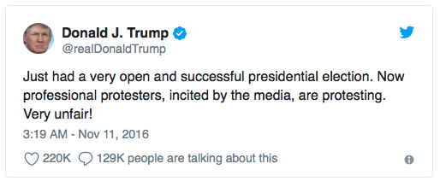
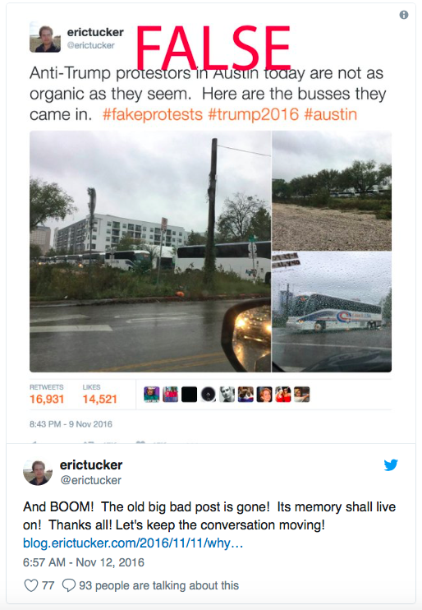
5. Nov. 10, shortly after 9 p.m.
Donald Trump sent this tweet:
6. Nov. 11
Tucker’s tweet continued to generate thousands of shares on Facebook through various sites and organisations.
After midnight, Mr. Tucker was forced to delete his tweet, then posted an image of it stamped with the word “false”. It did not receive much attention.
Faced with the impact of his actions, Mr. Tucker wrote: “Anytime you see me in the future going out there where I think there’s going to be a big audience, I can assure you I’m going to try my best to be balanced with the facts and be very clear about what is opinion and what is not”.
If he could go back, he said, “I might have still tweeted it but very differently. I think it goes without saying I would have tried to make a more objective statement.”

Slide 13
Discussion:
What factors contributed to the spread of Tucker’s fake news?
What were the results of the initial tweet?
What were the key moments involved in the circulation of the tweet?
What might Tucker have tweeted instead which would not have generated such a huge backlash?

Slide 14
Real life consequences.
Fake news can often seem like a petty nuisance, perhaps giving you misleading information about a celebrity or TV show.
However, fake news can have dangerous consequences.
It can use scaremongering to build upon underlying fears felt by a society. This can lead to panic, distrust or the stirring up of hate against individuals, minority groups or even whole countries or nationalities.

Slide 15
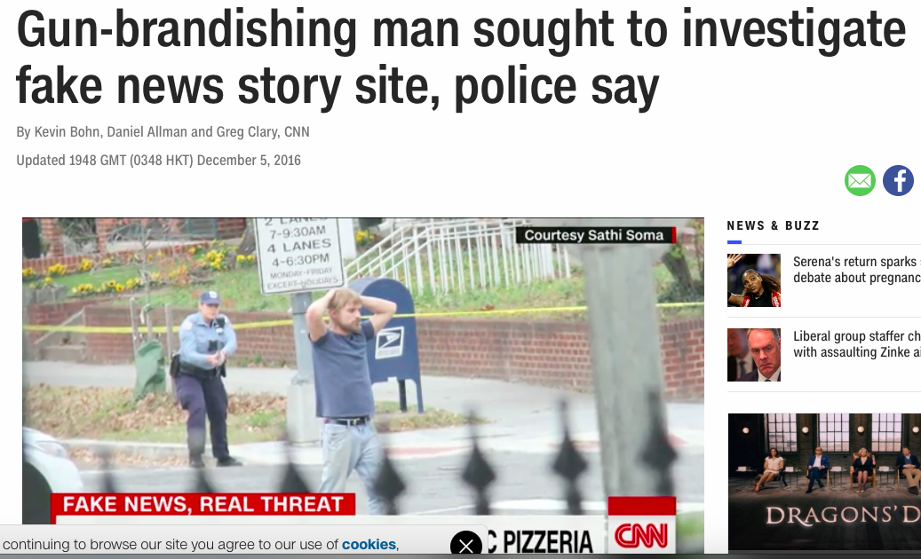
Stories online suggested Hillary Clinton and her senior aides were running a child abuse ring from the restaurant. In December, a man travelled hundreds of miles across America to hold a restaurant up at gunpoint.

Slide 16
A made-up quote from Israel’s defence minister, spread online, suggested Israel was considering a nuclear strike on Pakistan. Pakistan’s defence minister responded on Twitter: ‘Israel forgets Pakistan is a nuclear state too’.

Slide 17
Fact VS Opinion – Know the difference!
Fact: A thing that is known or proved to be true
Opinion: A view or judgement formed about something, not necessarily based on fact or knowledge
Whilst the news often contains a mix of fact and opinion. Fake news is commonly misleading in its incorrect use of opinions as facts.

Slide 18
Some forms of fake news:
Viral hoax – These will often lack wider motives beyond ridiculing those who believe them. However, credible news outlets can accidentally circulate the hoax into the wider public domain if they report it without checking the facts.
Clickbait - a method of enticing online users to click on links, content and ads by using sensationalist, crude or misleading headlines.
Satirical news sites/stories – intentional news parodies which may use satire or fanciful hypothetical examples to make a point. However, some readers may mistake it as fact, especially if its source becomes unclear when stories get shared on social media feeds.
Biased news - events told from a particular point of view, usually full of exaggerations and often missing vital facts. The purpose is to get readers to think a certain way about a story.

Slide 19
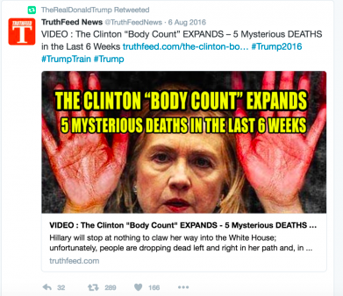
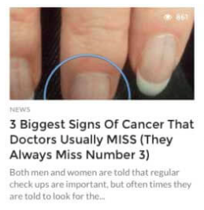
Activity: Create a ‘clickbait’ headline
Using 20 words or less, write a ‘clickbait’ headline you might see on a social media platform, base your piece on a current news affair.

Slide 20
How to spot fake news:
Check the source – Look past the story to consider the website, its mission and its contact information. Pay attention to the domain and URL – trusted news organisations have a standard form you will be familiar with e.g. .com/.net/.org/.co.uk
Check the author – Are they credible? Are they real? Do they have more than one published story?
Read beyond the headline – Don’t be a victim of clickbait. Headlines are often made to be shocking without a story to back them up. What is the whole story?
Check for supporting sources - A lack of supporting quotes or research should be a warning sign. Genuine news stories will often include multiple quotes from experts or professionals in the field. Are there named sources (‘Sources say’ or an unnamed source offers little value)?

Slide 21
Could it be a joke? – If the story seems too bizarre, unexpected or funny then it may be an online prank, hoax or satirical piece. Research the story, site or author further to make sure.
Ask for a second opinion – If the story is genuine then there should be more information elsewhere that will confirm it. Search the quote or statement using a search engine or fact checking site to see if it is backed up elsewhere. You could also discuss the story with a trusted adult or professional and get their opinion.
Check the date – Old news stories can easily recirculate yet they will often hold little relevance for current debates or affairs. They may also have been disproved or rewritten since their original publication.

Slide 22
THINK before you share, retweet, ‘like’ or send a story.
Don’t add strength to fake news.

Slide 23
Activity: Create a fake news story
In pairs or small groups write a 300-word fake news story which could fool the public.
Make up some fake research or data which could persuade people that your story is real.
Include some quotes which could make your story seem more reliable
Try to include some wild exaggerations and expressive language
Remember to give your story a source, date and author.

Slide 24
Discussion…
How might someone determine that your story is fake?
Where might you find your story published?
Why is it important for people to be aware of fake news?

