Slide 1
Books as treasures The power and joy of owning a book
Judy Clark
Primary Advisor
Notes:
Download the accompanying guidance notes

Slide 2
Hello and welcome!

Slide 3
What do books mean to you?

Slide 4
A bit of book gossip…
Share your favourite book. Why do you love it so much?
©National Literacy Trust 2016
https://www.flickr.com/photos/brioso/

Slide 5
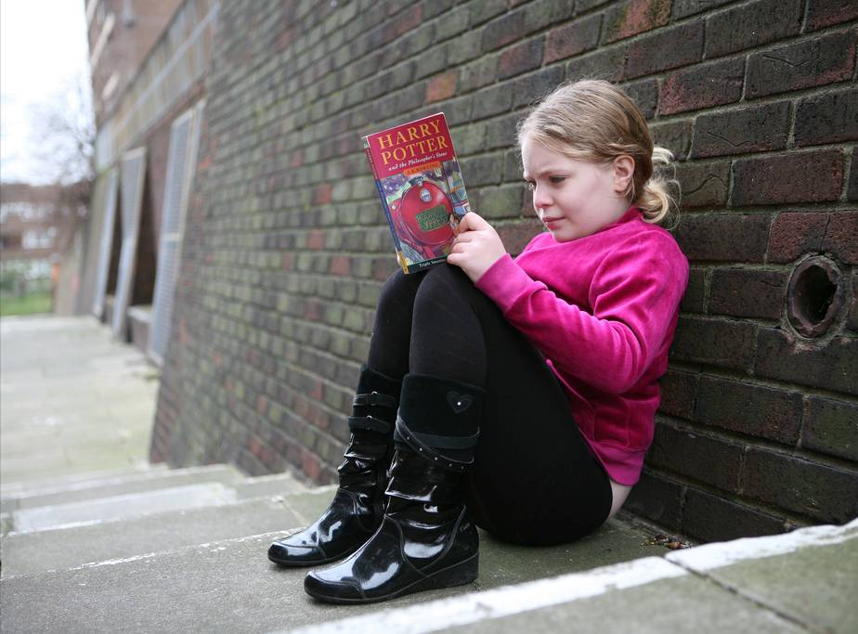
Owning books matters…
“Children growing up in homes with many books get 3 years more schooling than children from bookless homes, independent of their parents' education, occupation and class.”
Notes:
Source: Family scholarly culture and educational success: books and schooling in 27 nations. MDR Evans, Jonathan Kelley, Joanna Sikora and Donald J. Treiman (2010)

Slide 6
Did you know?
Children who are book owners are more than 20% more likely to read above their expected reading level than students who do not own books
Children who read outside class daily are five times as likely to read above the expected level for their age
Children who own books read more books and show greater enjoyment of reading than children without books in the home
Children who do not have access to books are less likely to engage with a variety of other reading and writing forms such as emails, websites, magazines, and newspapers
Notes:
Sources:
Clark, C., Poultan, L. (2011). Book ownership and its relation to reading, enjoyment, attitudes, behavior and attainment. London: National Literacy Trust. Clark, C. (2016). Children’s and Young People’s Writing in 2015. Findings from the National Literacy Trust’s annual literacy survey. London: National Literacy Trust.

Slide 8
What can we do as a school community to celebrate books?
http://www.enchantingquotes.com/trinbo.html

Slide 9
Library fun
Book groups
Making books
Book blog
Sharing stories
Talking books
Reading journeys
https://www.flickr.com/photos/eekim/
Recommended reads
Book trailers

Slide 10
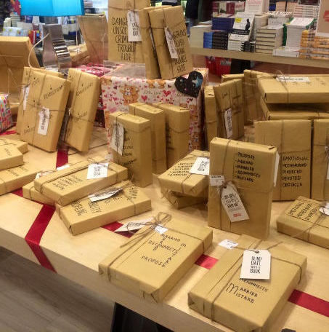
The Gift of Reading
Christmas/Summer Fayre Book Stall
Choose your book
Wrap in brown paper
Write an advert for your book
No titles allowed!
https://www.bookstr.com

Slide 11
And finally

Slide 12
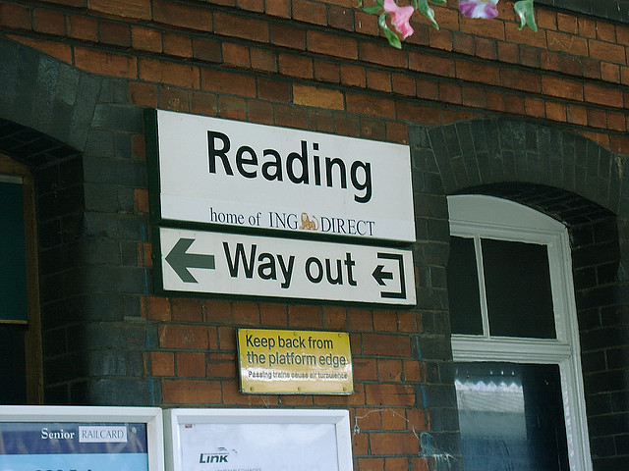
https://www.flickr.com/photos/60572130@N00/

